Slide 1

Final Prototype Demonstration: TerraProbe
A Down2Earth (D2E) Company
4/23/2025
Notes:
Jacob

Slide 2
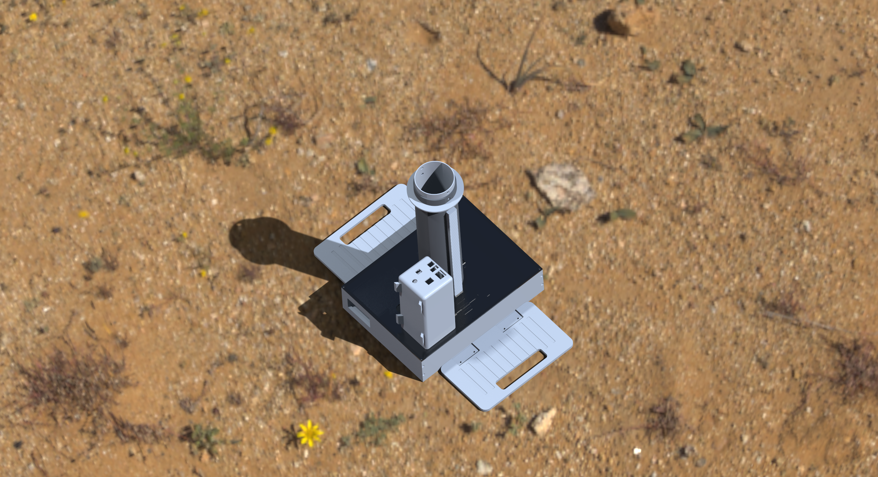
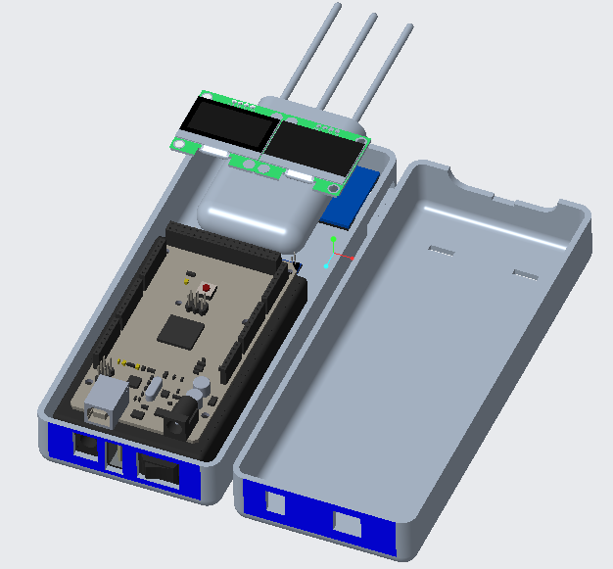
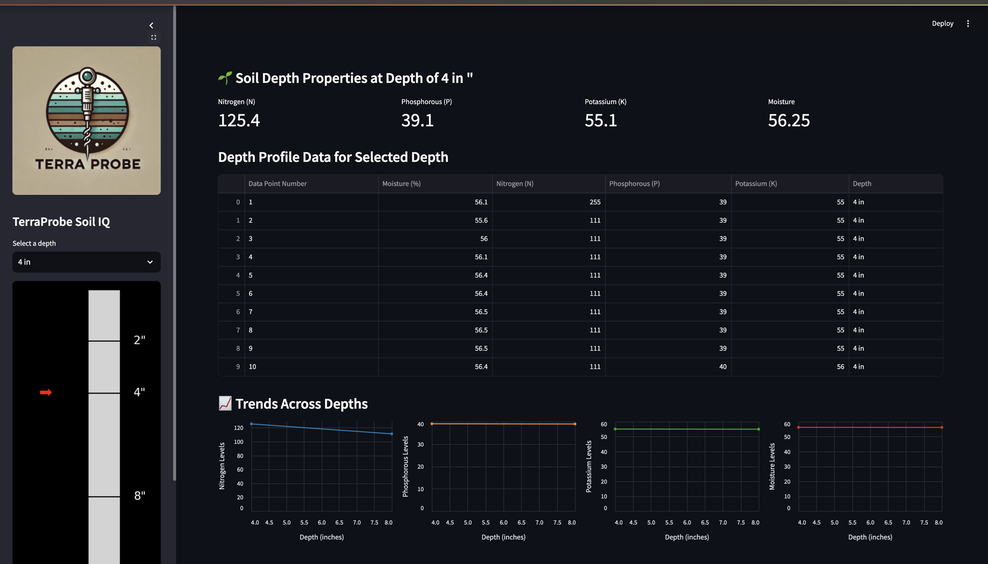
Recap of TerraProbe Products
All-in-one solution encompassing burrowing, testing, and analytics
TerraProbe Soil Sampler
Soil Testing Probe (DAQ)
SoilIQ Dashboard
Compact, Portable & Handheld Soil Sampling Device (9”x 12”x 17”)
Utilizes Rack and Pinion Mechanism for motorized power and downward movement (12” Deep)
Sensor Module for on-site analysis capturing key parameters
Nitrogen, Phosphorous, Potassium (NPK)
Moisture
Readings taken at slits on the inner payload
Digital platform to visualize NPK and moisture data at various depth profiles
Converts SD card data from DAQ into interpretable tables and charts
Notes:
Jacob

Slide 3
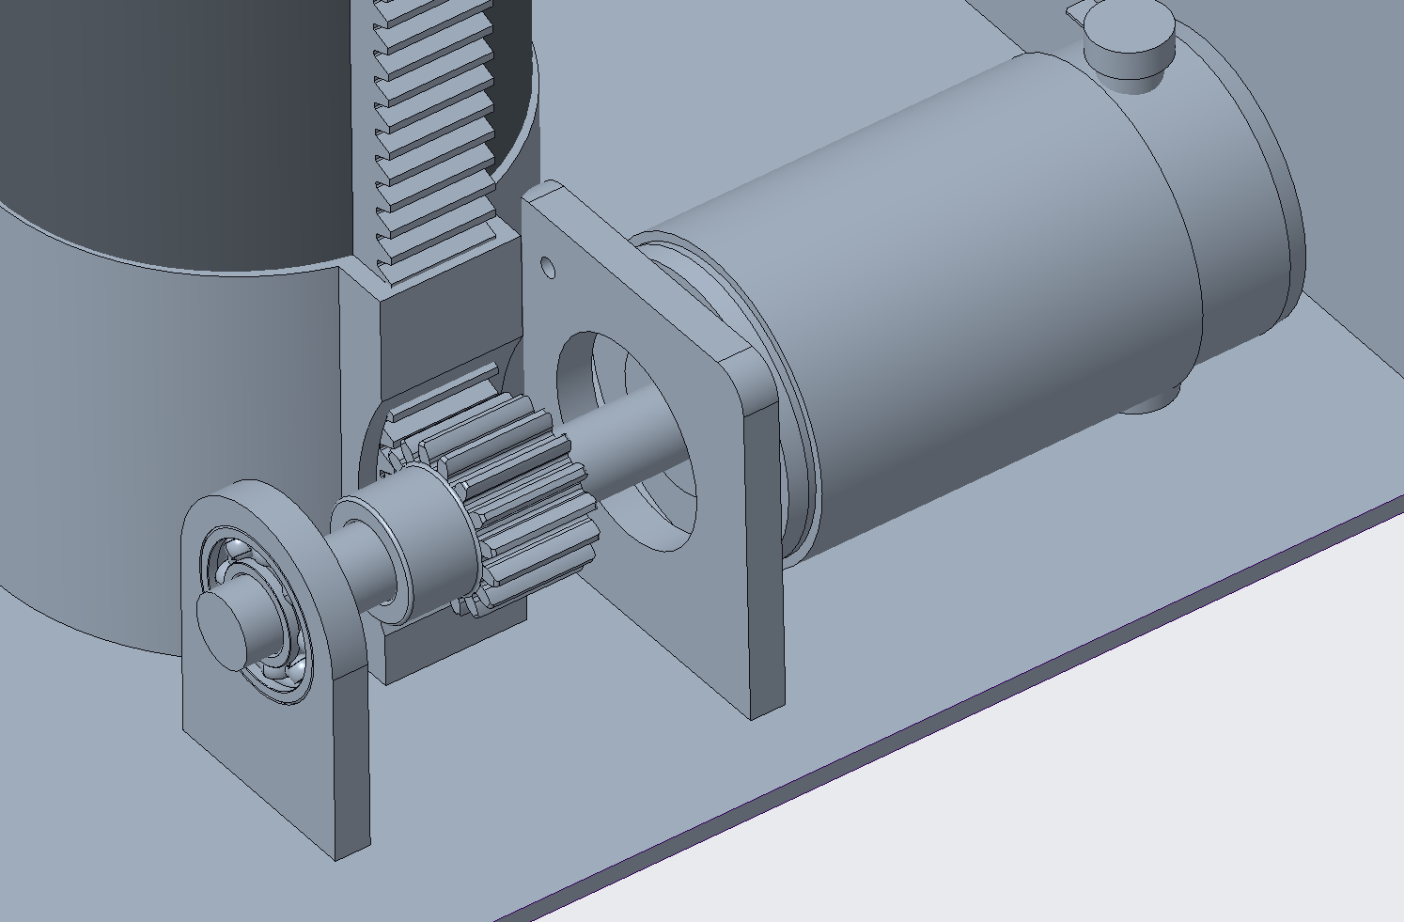
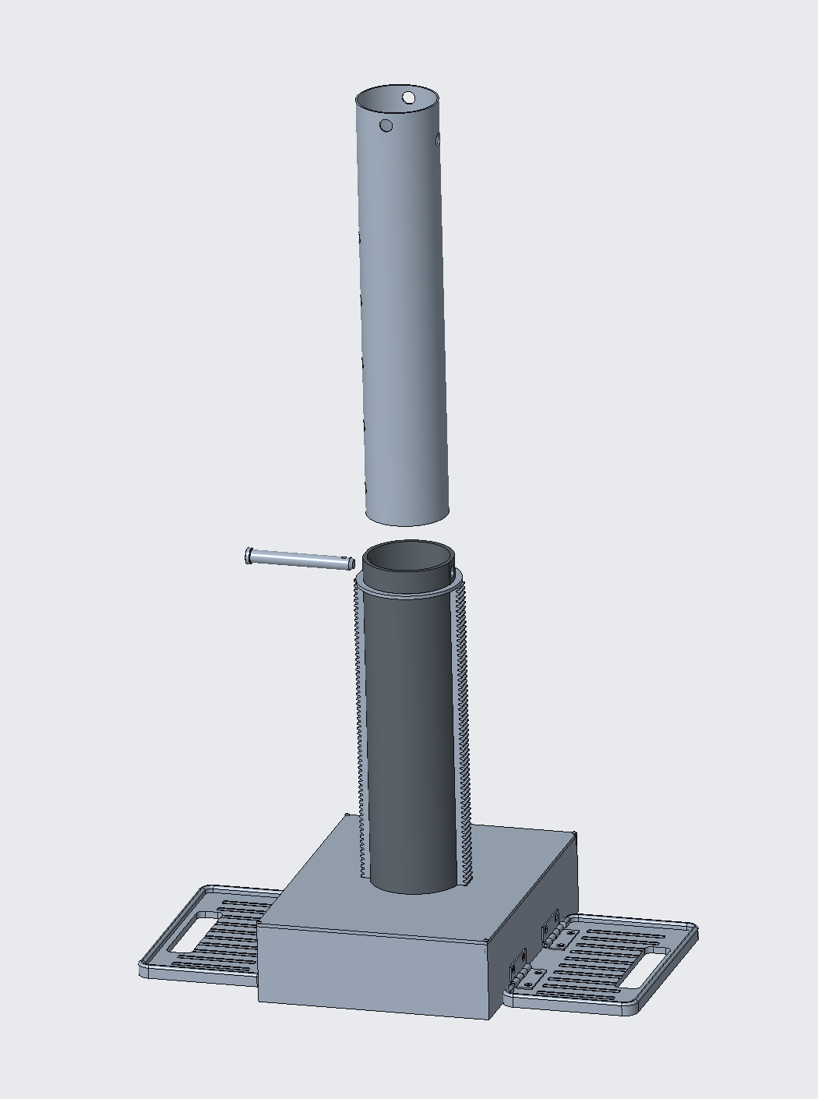
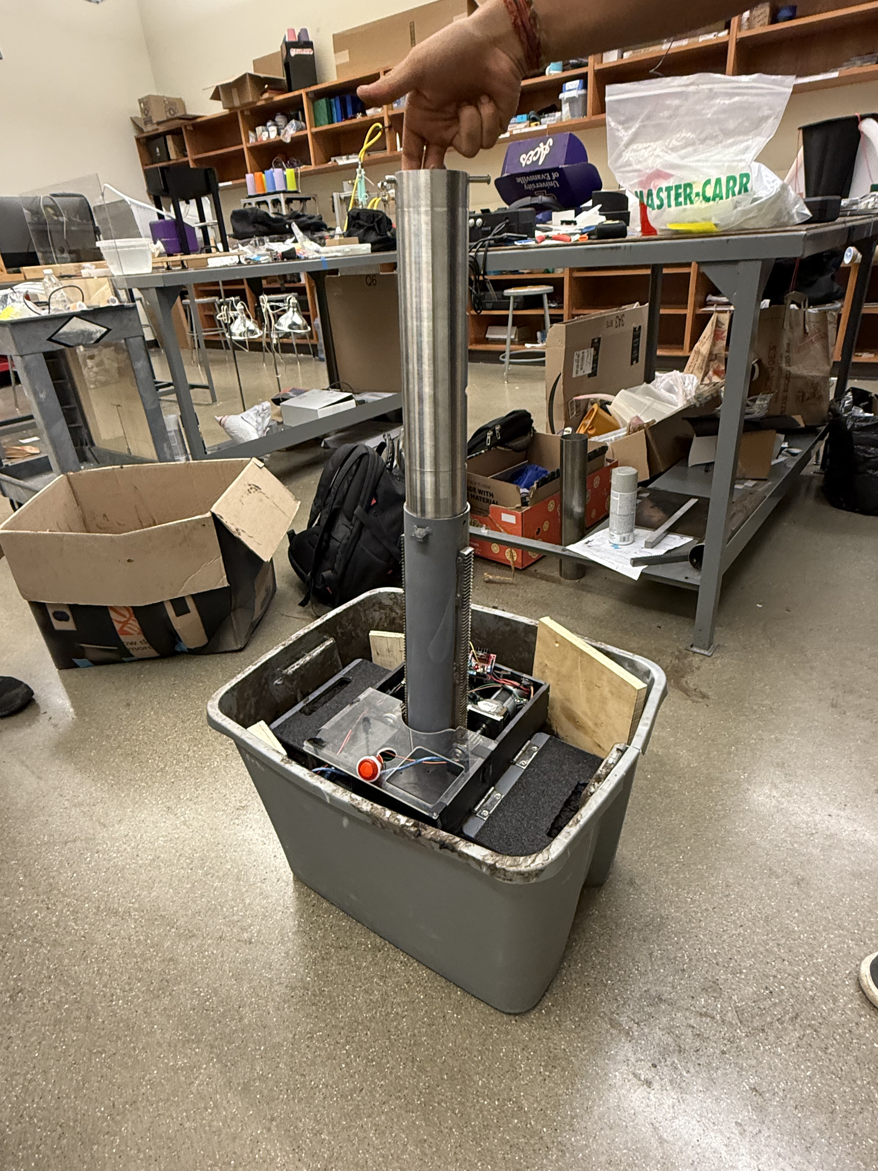
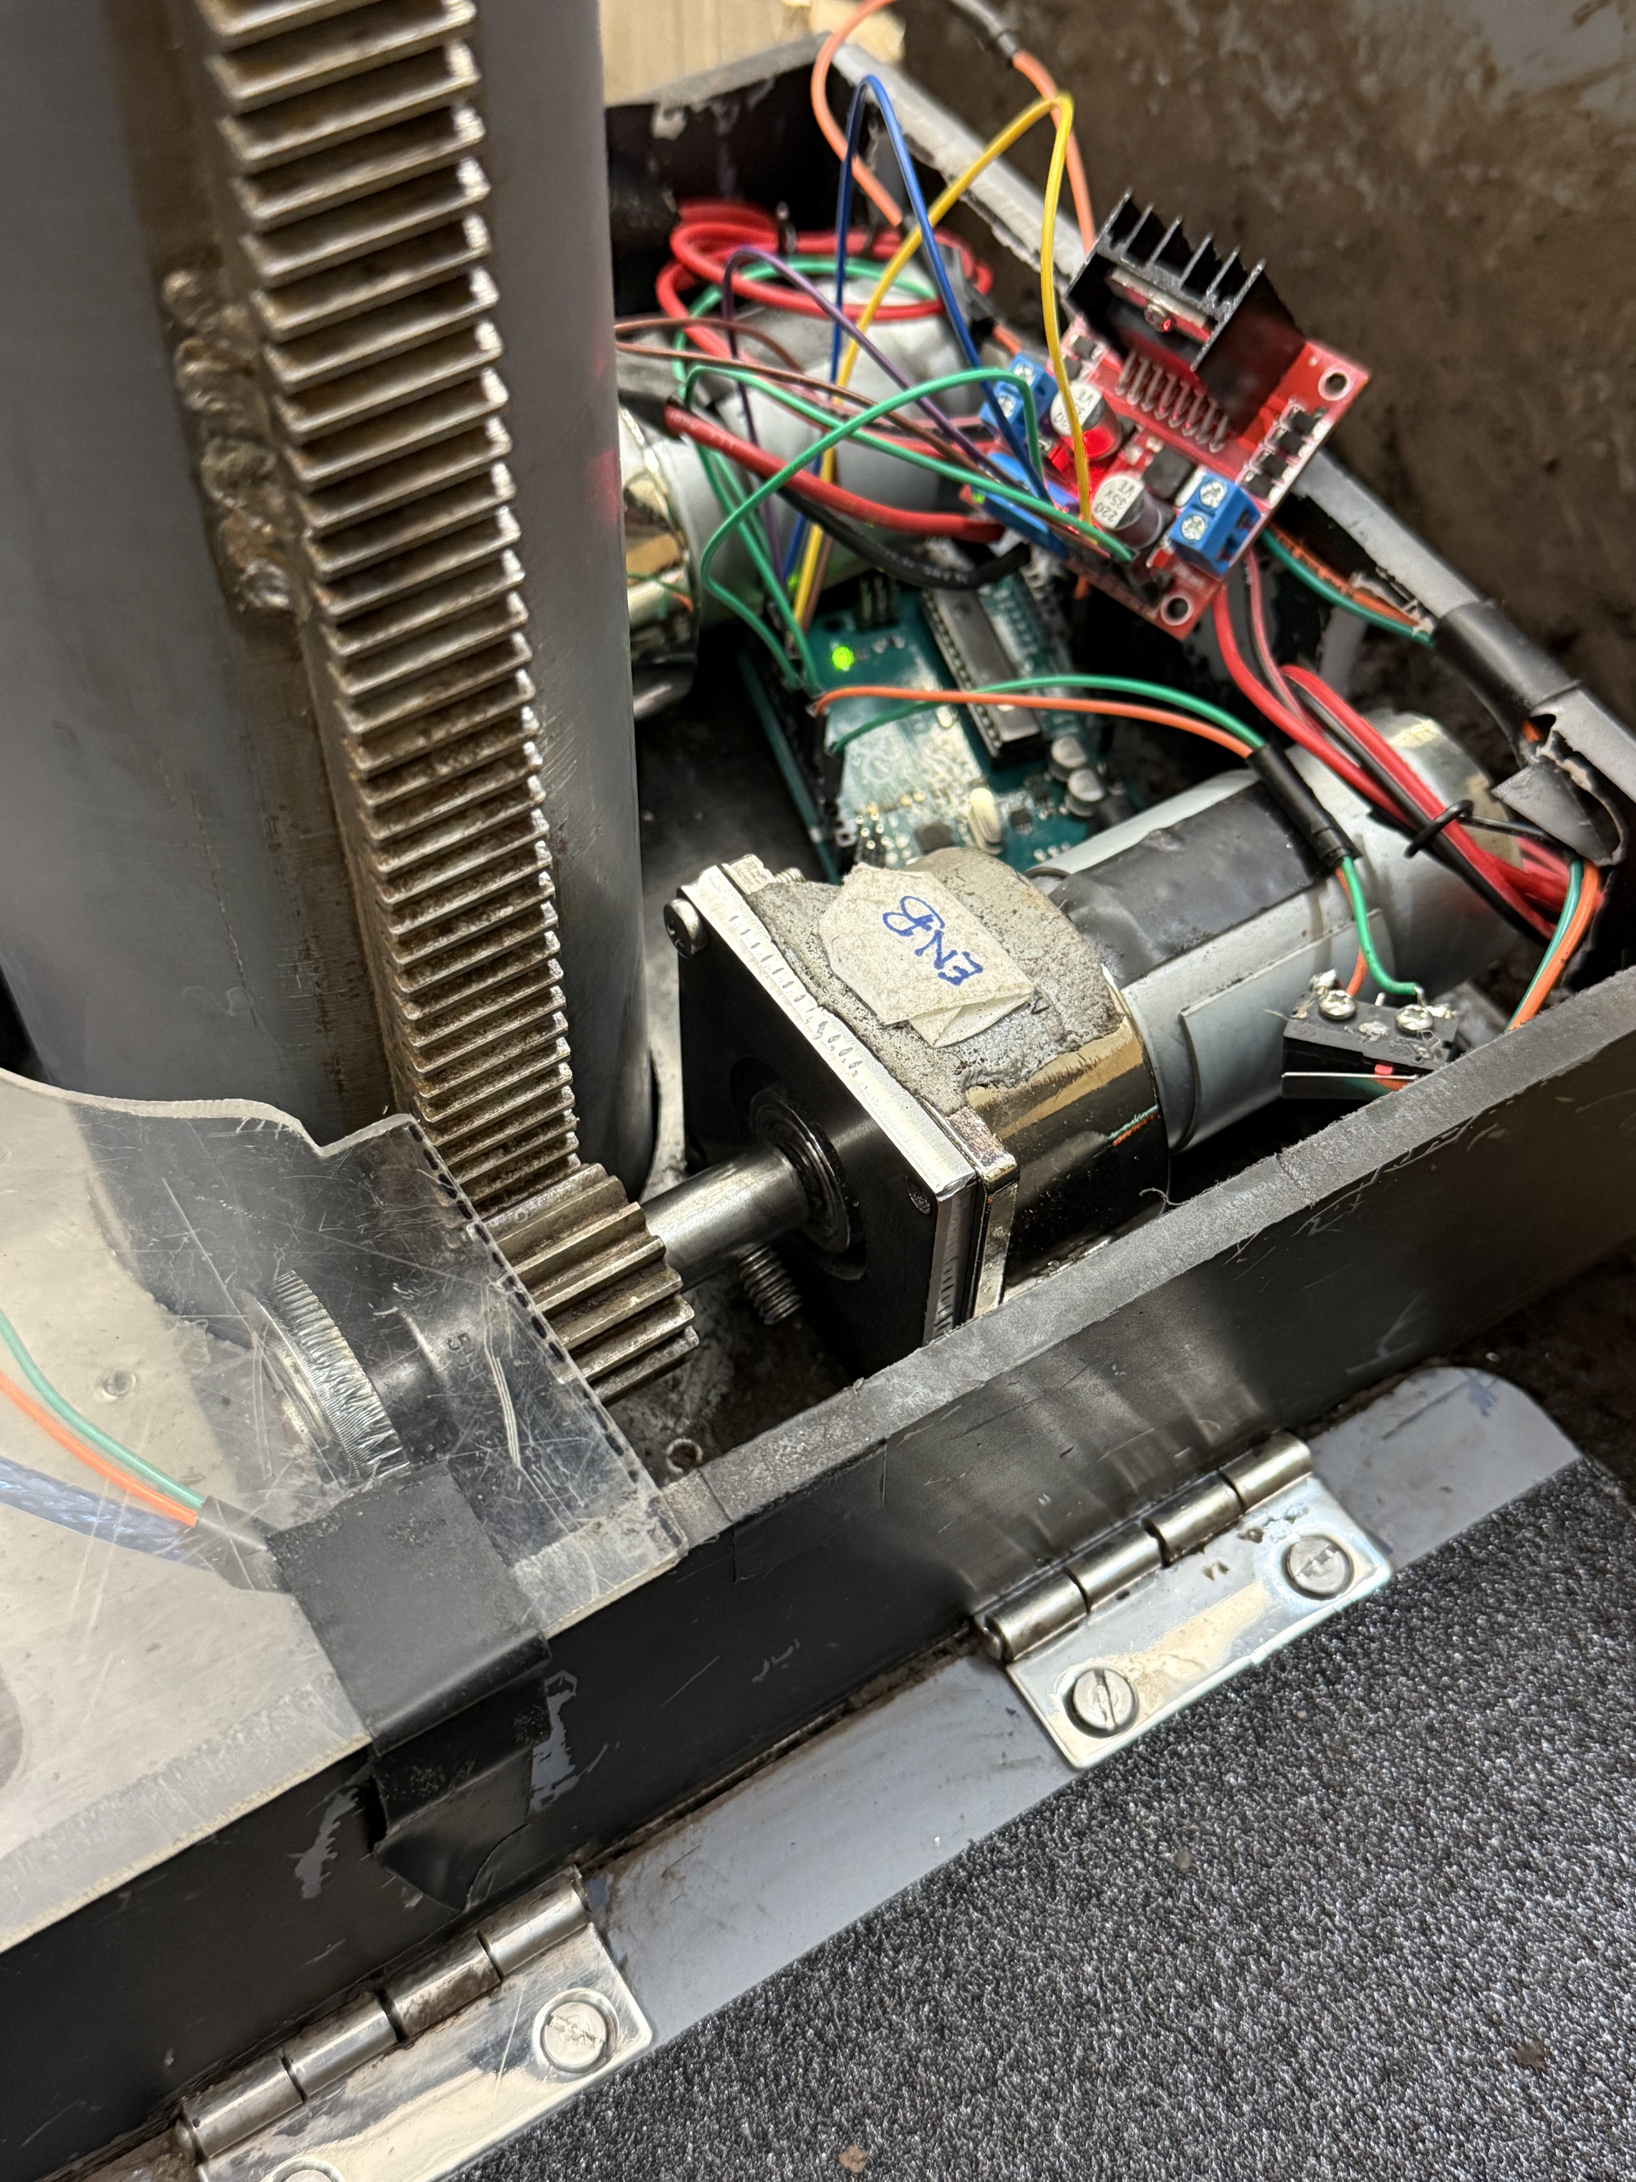
TerraProbe - CAD vs. Production Prototype
Comparison of Soil Burrowing and Sampling System Design & Prototype
Notes:
Chris

Slide 4
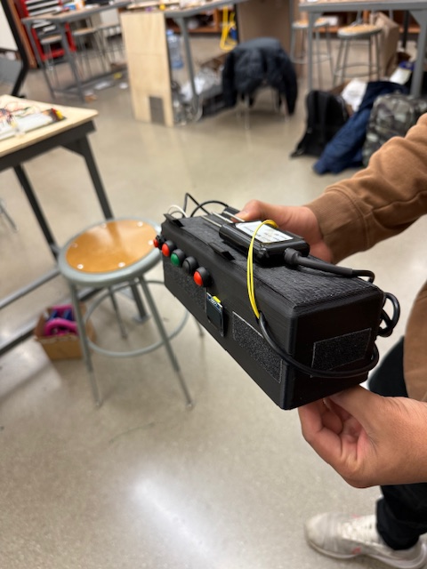
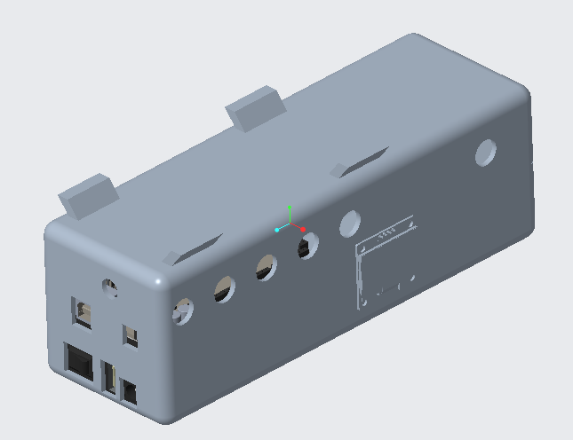
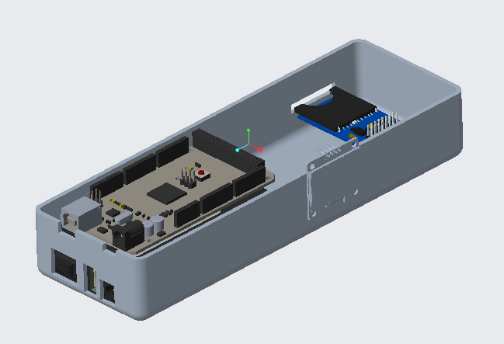
Testing Probe - CAD vs. Production Prototype
Comparison of Soil Testing System CAD & Prototype
Notes:
Jacob

Slide 5
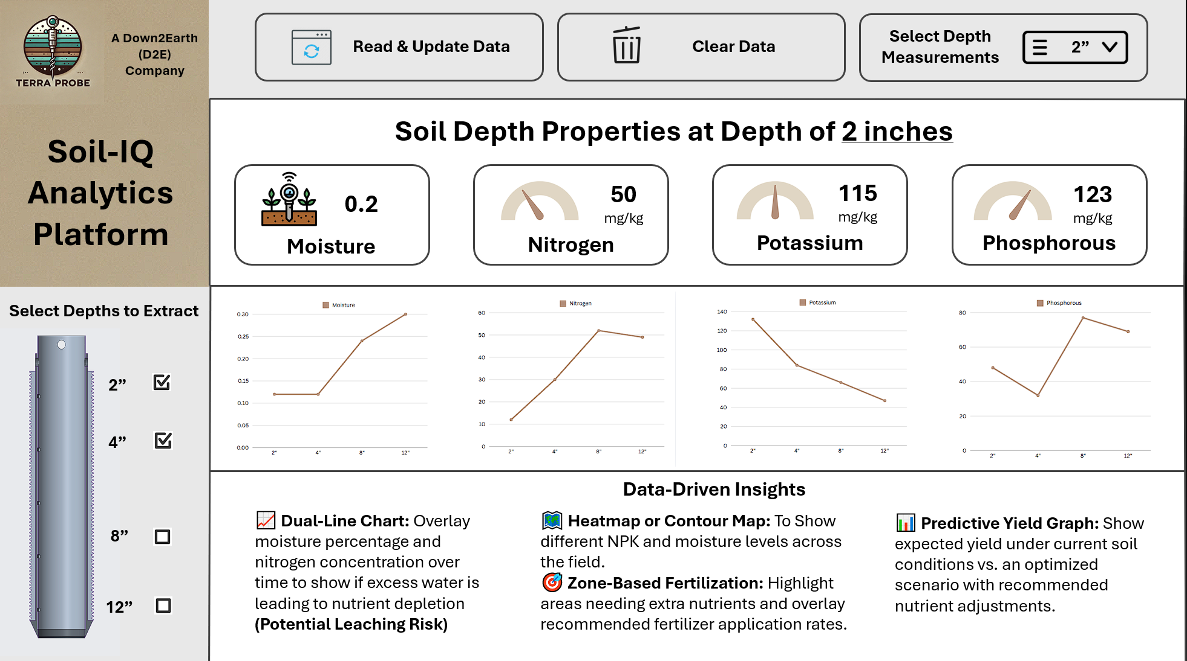
SoilIQ Dashboard - Design vs. Production Prototype
Comparison of SoilIQ Dashboard System Design & Prototype
Notes:
Sankaran

Slide 6
Video of Actual Test and Working Product
TerraProbe Solution Video
Final_Demonstration_Video.mov
Notes:
https://purdue0-my.sharepoint.com/:v:/g/personal/iyerss_purdue_edu/EUvF5XoCkNBDg_ZGU85cd40BUlnRd2LQ1nEpIN4x47TlFQ?nav=eyJyZWZlcnJhbEluZm8iOnsicmVmZXJyYWxBcHAiOiJTdHJlYW1XZWJBcHAiLCJyZWZlcnJhbFZpZXciOiJTaGFyZURpYWxvZy1MaW5rIiwicmVmZXJyYWxBcHBQbGF0Zm9ybSI6IldlYiIsInJlZmVycmFsTW9kZSI6InZpZXcifX0%3D&e=af6z5Z

Slide 7
Functional Requirements – Targets vs. Actual Performance
TerraProbe partially meets the functional requirements outlined
Requirement | Target | Actual
Portability | < 25 kg, compact | 11.8 kg, 9” x 12” x 16.5” - Compact
Motorized Operation | Run independently without user effort | Has Motorized Operation but requires user supervision and careful assembly
Auger/Core Sampling Mechanism | Sample down to 12 inches | Samples down to 6.5 inches
Depth Accessibility | Distinct samples from 0–2 in, 2–4 in, 4–8 in, 8–12 in | Distinct samples from 0–2 in, 2–4 in
Soil Type & Compactness | Device burrows through different amount of soil compactness | Easily burrows through cohesive soil but not dry soil
Motor Control | Provide a minimum of 30 RPM force | Provides ~22.5 RPM (Lower than excepted) 120 lbf MAX Force and 90 lbf Steady State
NPK Data Capture | Values for Nitrogen, Phosphorus, and Potassium | Functions as intended and captures moisture as well
Dashboard ML Model Accuracy | >= 85% Model Performance Accuracy | 92.2% Model Accuracy
Cost Efficiency | Prototype development cost from $600-1000, with sell price <$1500 | Prototype development cost ~$980
Notes:
Sankaran

Slide 8
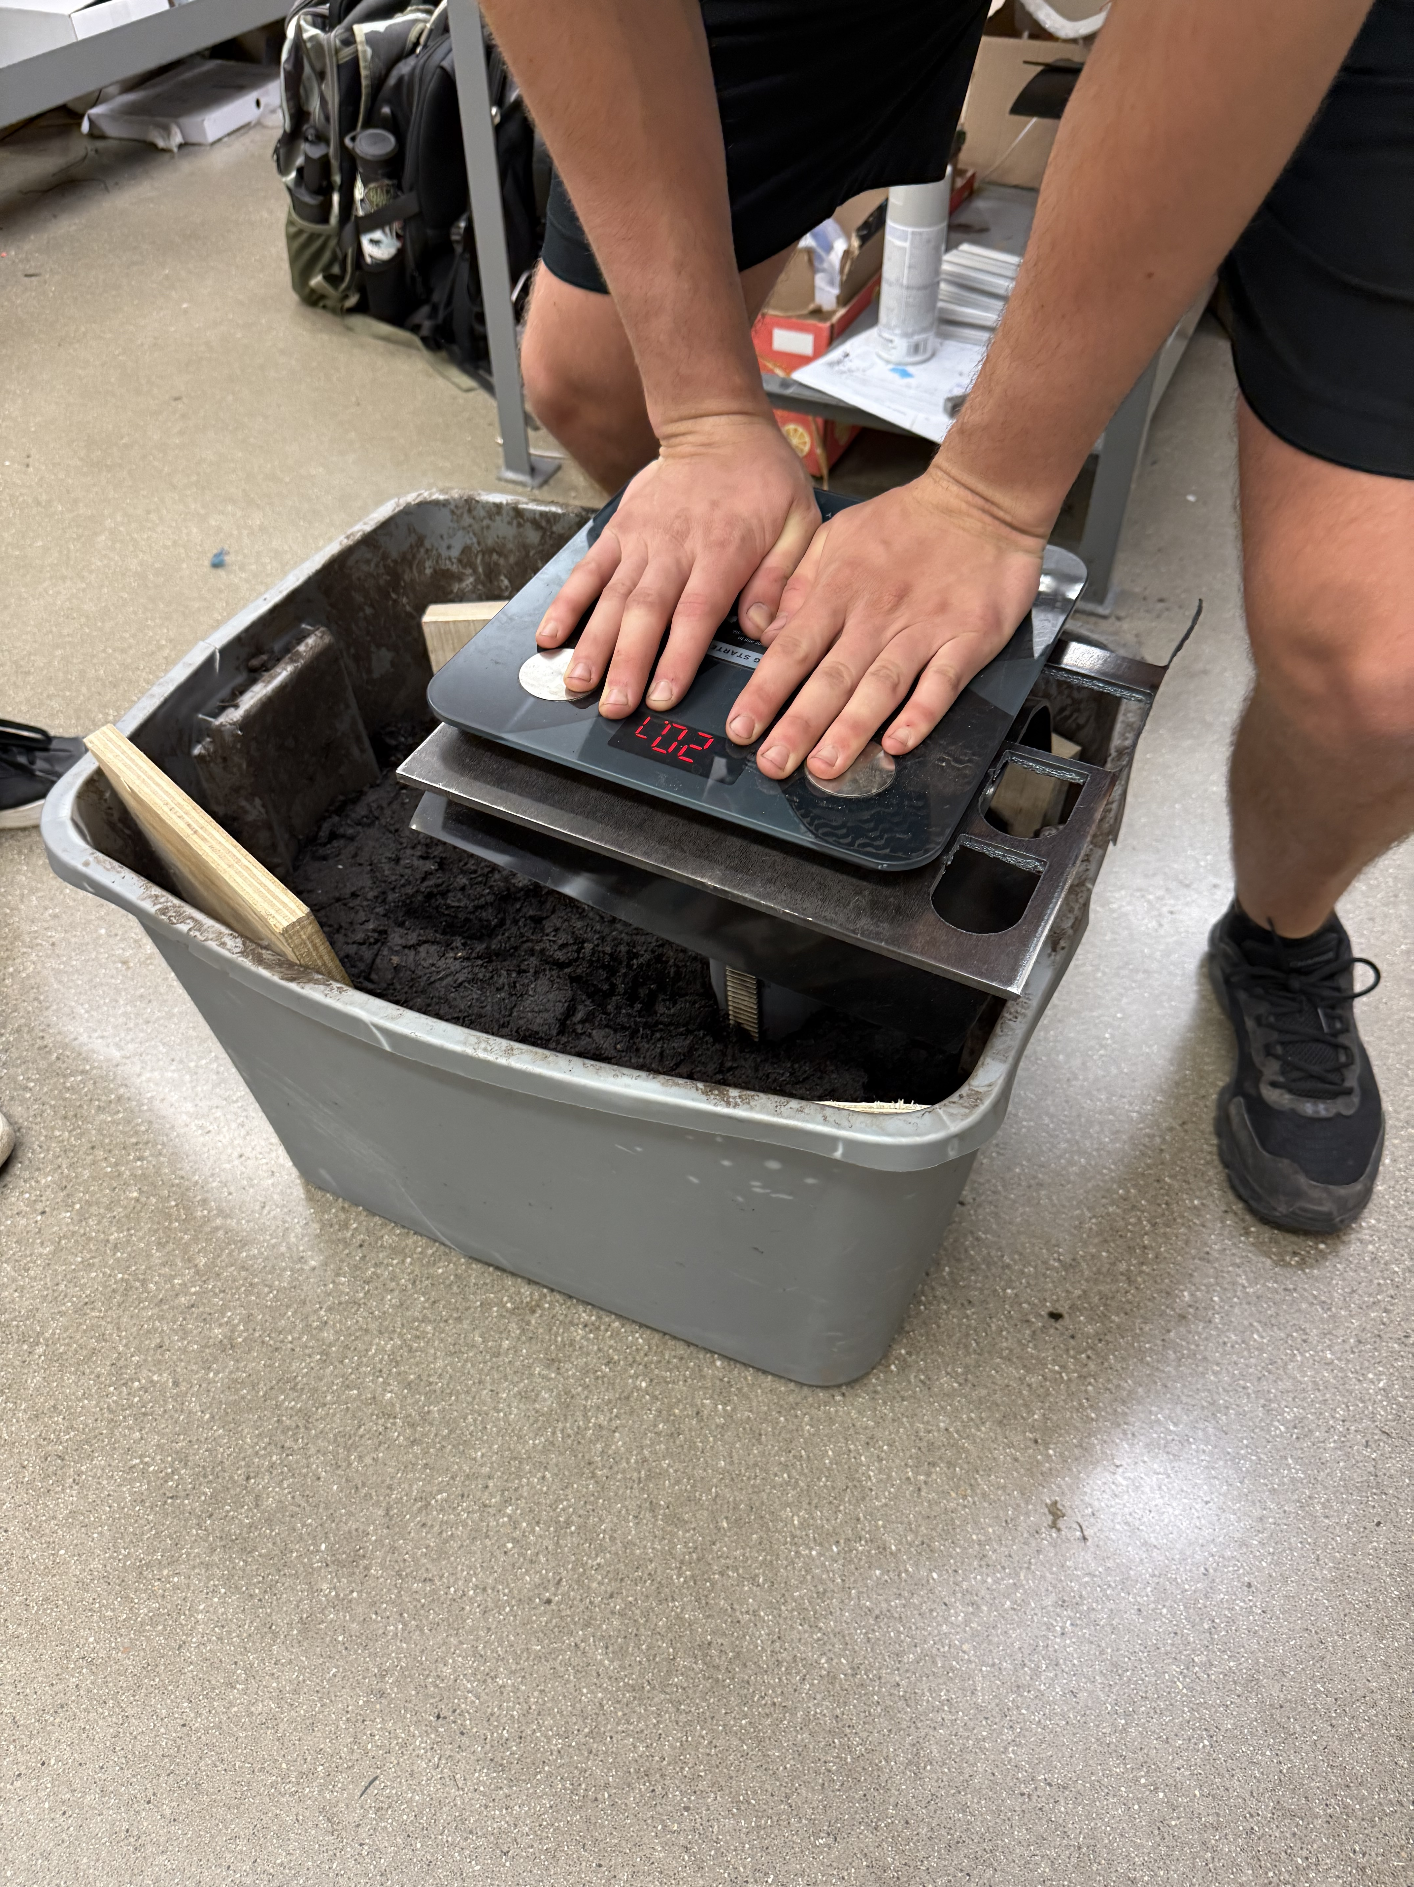
Validation Tests – Force Test
Future scope will require higher powered motors for faster and optimum user experience
Force Test
Placed a scale on top of the shell and payload to examine force to burrow down
Pushed down to obtain maximum force value that can be applied using hands
Implications
Force required to push down using hands is 120-130 lbf
Motors provide a max force of 120 lbf with 90 lbf steady state
Collected around 6-7 inches in both manual and actual test
Takeaways
Perform motor tests to identify RPM and Power impact on motor
Notes:
Avie

Slide 9

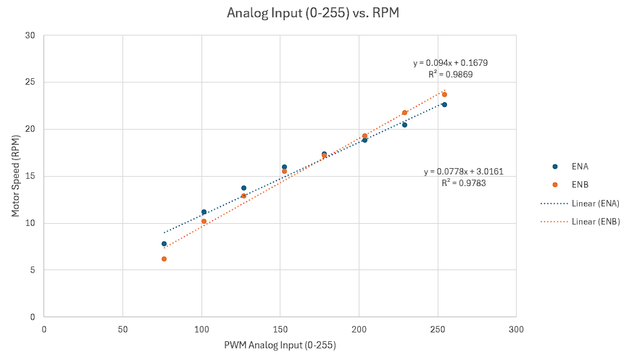
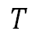
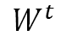
Validation Tests – Motor Calibration & Depth Testing
PWM Motor Output and Depth Performance testing
Motor Calibration – PWM Input vs. RPM Output
Baseline to understand how motor speed affects soil penetration
Linear Motor Performance
Goal: Run both motors at the same speed to avoid slip/tilt
Stiction
Motors begin rotating only above ~30% input (≈76.5 PWM). Below this threshold, torque is insufficient to overcome static friction
RPM vs. Torque
Low RPM → Higher Torque
Applicable for initial soil penetration due to requirement of force)
High RPM → Lower Torque
Suitable for faster motion but offers less pushing force – not ideal in compact soil
$$T$$
$$W^{t}$$
RPM vs. Depth
Lower RPMs did NOT result in any measurable burrowing, despite motors running
Why Low RPMs Failed?
PWM controls power, not just voltage
Longer PWM cycles reduced the average current delivered
RPM | ENA PWM | ENB PWM | Depth (in)
22.8 | 255 | 255 | 3.5
22 | 244 | 232 | 2.75
18 | 192 | 190 | ~1” (Did not run)
14 | 141 | 147 | Did not run
Notes:
Lokesh

Slide 10
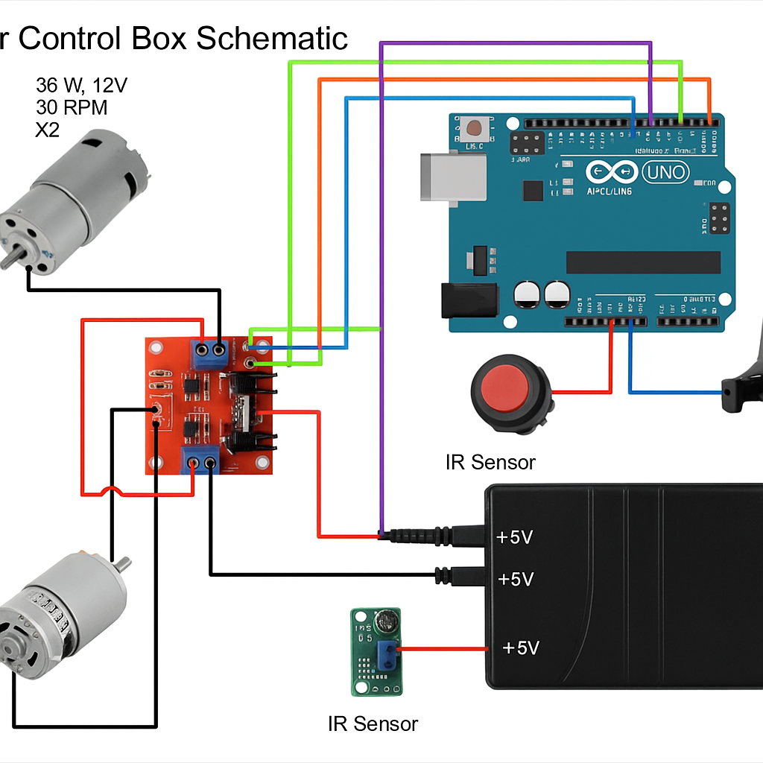
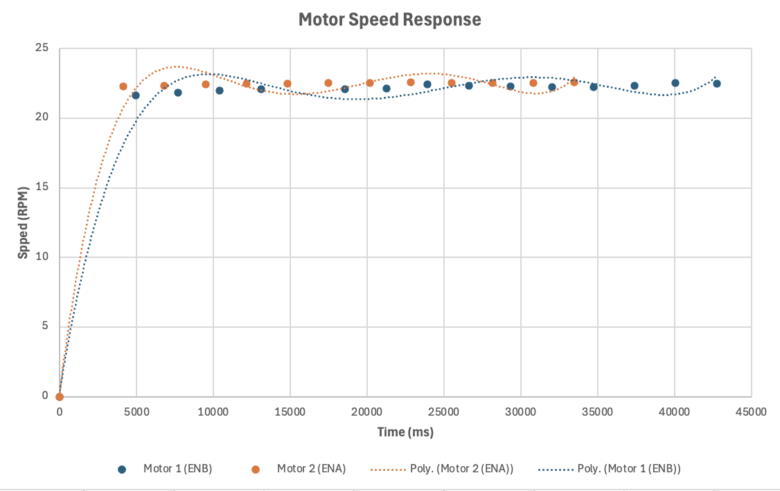
Validation Tests – Motor Performance
Future scope will require higher powered motors for faster and optimum user experience
Motor Design & Sizing
Selected a minimum of 35W, 12V motor at 30 RPM
Required force calculated as 923.4 N for stiff cohesive soil
Motor Speed Test
Connected IR sensor to measure the pulses per revolution of the motor
Motors are underperforming
Performed IR Sensor Test to examine motor speed response data over time
Motors are running at MAX speed
Motors steady state speed: ~22.5 RPM
Motor Rise Time: ~5 seconds
Implications
Longer time to burrow into the soil
50 RPM motors necessary
Notes:
Avie

Slide 11
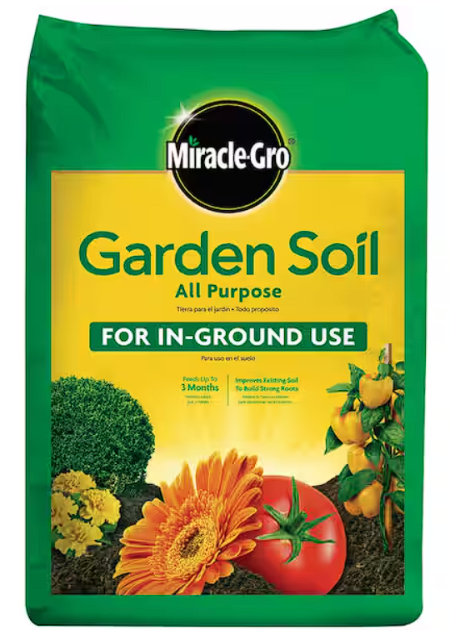
Validation Tests – Soil Compactness vs. Depth Performance
TerraProbe tests how well it can perform on wet vs. dry soil
Water Added (oz) | Approx. Condition | Depth Burrowed (in)
0 | Powdered | 1.21
128 | Dry & Loose | 1.75
256 | Lightly Moist | 2
320 | Lightly Moist | 3.93
384 | Moderately Moist | 5.56
512 | Dense | 6.72
Test Procedure
Base material: Dry garden soil (~5,000 in³)
Incrementally added 128 oz of water per test (~5% volume each time)
Measured depth burrowed (inches) after each addition
Simulates real-world changes in soil density and compactness
Soil Condition
Powdered
Dry & Loose
Lightly Moist (Slightly Cohesive)
Moist (More Cohesive)
Moderately Dense (Slightly sticky)
Dense (Sticky)
Initial High Resistance
Dry soil offers high resistance due to lack of cohesion.
As moisture increases, soil cohesion improves, making it easier for the probe to burrow.
Higher Moisture Levels, Greater Depth Sampling
At high moisture levels (384–512 oz), soil becomes sticky and compact, which aids in deeper penetration by maintaining contact and reducing kickback.
Base Material: Dry Garden Soil (5174.8 cubic inches)
Notes:
Lokesh

Slide 12
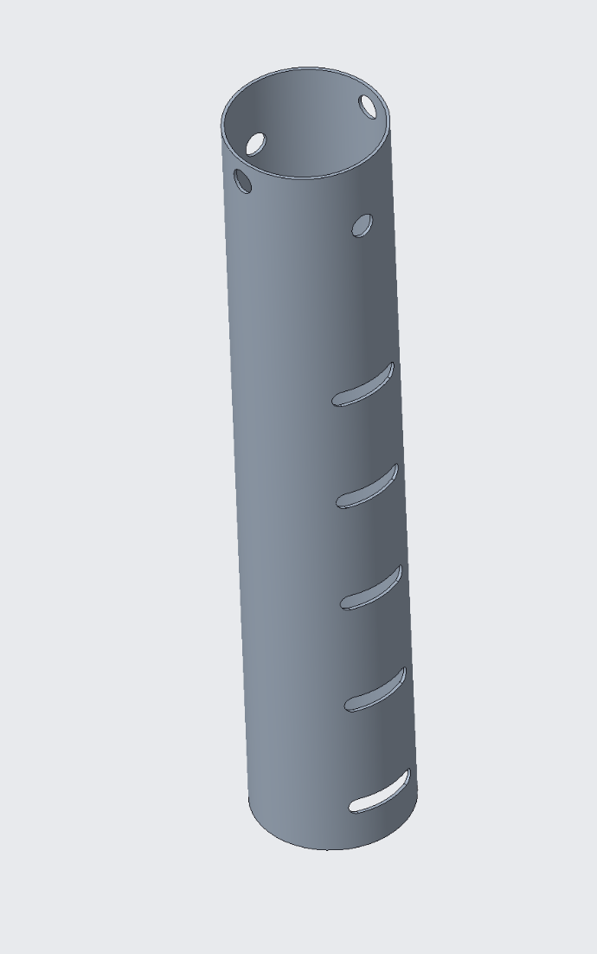
Validation Tests – NPK & Moisture Sensor Precision
TerraProbe tests how well the testing probe precision performs
Trial Number | Nitrogen [mg/kg] | Potassium [mg/kg] | Phosphorous [mg/kg] | Moisture (%)
1 | 8 | 3 | 4 | ~67%
2 | 8 | 2.5 | 4 | ~69%
3 | 8 | 2 | 4 | ~69%
4 | 8 | 3 | 4 | ~66%
Average | 8 | 2.625 | 4 | ~67.75%
Conducted 4 repeated trials on the same soil sample to assess precision of TerraProbe readings
Measured Nitrogen (N), Phosphorus (P), Potassium (K) levels and Moisture content
Observed consistent Nitrogen (8 mg/kg) and Phosphorus (4 mg/kg) across all trials
Potassium showed minor variation (range: 2–3 mg/kg)
Moisture readings stayed within a tight range (~66–69%), indicating stable sensor output
*Separate testing on Soil Cup
Notes:
Avie

Slide 13
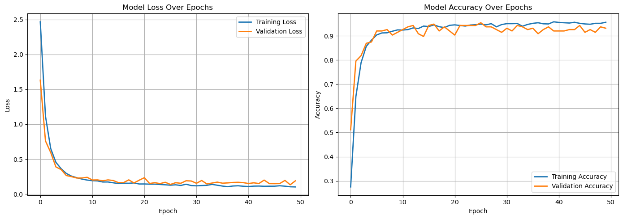


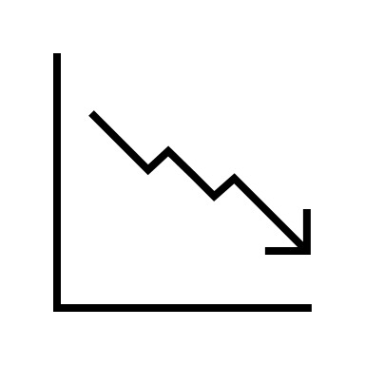
Validation Tests – Neural Network Performance
Neural Network based crop recommendation results are trustable and generalizable
# of neurons in the input layer (input features)
Predicted – Actual = Loss/Error
Crop Recommendation Data
# of neurons in the output layer (# of predicted variables)
loss function
# of hidden layers (each layer has certain number of neurons)
Train-Test-Split (80% Train, 20% Test)
Split crop recommendation data into different segments
Tested model on known data to identify accuracy
Model Accuracy: 92% (Greater than 85% Industry Standard)
Low to Negligible Model Loss
Loss indicates the difference between actual and predicted values
Low loss indicates that model performance is accurate and can be generalizable
Improvement and Limitations
Data is based on aggregate India parameters (NPK, Temperature, Humidity) – More data from other countries could help improve model generalization
Notes:
Sankaran

Slide 14
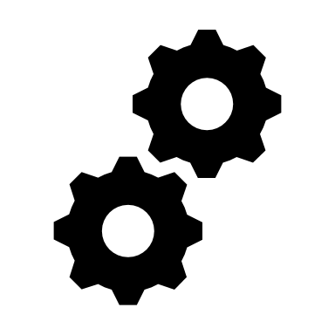

Improvements: Potential Failure Modes Simulation
Future scope will require higher powered motors for faster and optimum user experience
Failure Modes | Design Improvement
Soil is not compact enough to stick to payload | Added grip tape inside payload chamber to hold soil via friction
Motors not providing enough power | Plan is to replace motors with motors that maintain consistent power at lower RPM (voltage-controlled)
Motor direction unknown on startup | Programmed motors to default to forward motion (rack-down)
Wires interfering with gear/rack system | Mounted wires along sidewalls and added clips for better wire management
Foot Pedals breaking off due to excessive force | Used longer screws and attached bolts to the back-end
Top Lid made maintenance difficult | Redesigned lid by cutting into halves for quicker access to electronics (Future Plan: Add hinges to open and close lid anytime)
Shell Guide creates an interference with the rack | Removed shell rack from design as gears align smoothly with rack itself
Motor Performance deteriorates with lower battery | Batteries should always be ran fully charged, better and more powerful 12V batteries to be purchased for future iterations
Notes:
Chris

Slide 15
Learnings & Improvement Opportunities
TerraProbe will take key insights from the testing of production prototype to improve design & manufacturing
Higher Torque Motors
Current motors don’t provide sufficient torque for 12" depth
Battery life affects motor speed
As battery discharges, the internal source resistance increases, and less voltage appears across the terminals
Manufacturing Prototype
Larger base, cleaning protocol, and better cable management can be used for future iterations
Material Selection
Foot pedals are a failure point and steel could have been used rather than UHMW plastic
DAQ System
Better holding case (handle), smaller circuit and PCBs could replace majority of wiring for the system
Notes:
Avie

Slide 16
Thank You!
TerraProbe Team, A Down2Earth Company ☺
Notes:
Jacob

